Slide 2
Improving prevention choice while we wait for an HIV vaccine: Prioritizing resources for key population-specific prevention research and implementation
Mitchell Warren, AVAC
@HIVpxresearch
Share your thoughts on this presentation with #IAS2019

Slide 3
Conflict of Interest Disclosure
No conflict of interest
AVAC accepts no funding from pharmaceutical companies

Slide 4
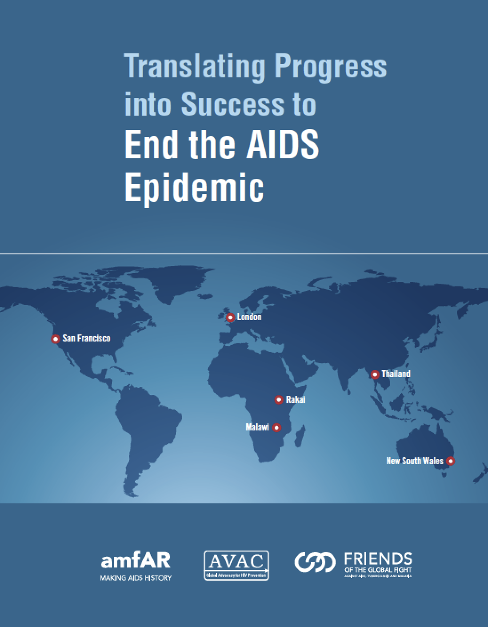

Slide 5
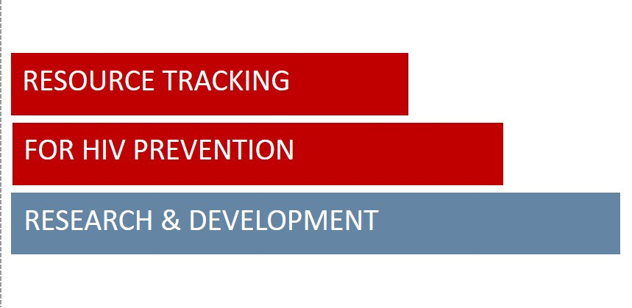
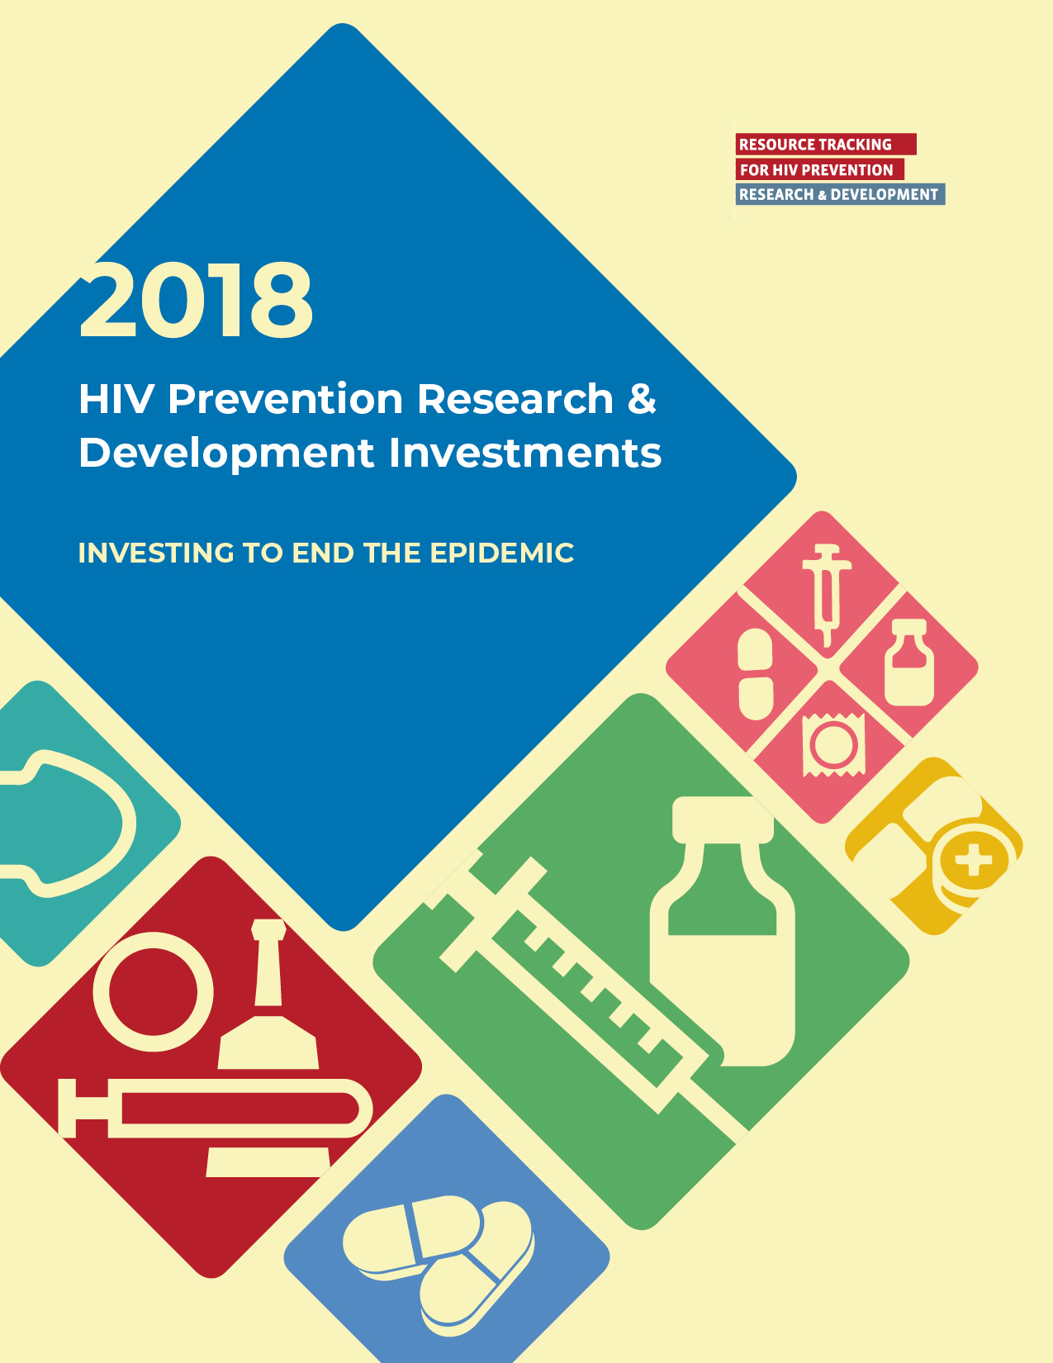
The “ Working Group” at a Glance
Since 2004, the Resource Tracking for HIV Prevention Research and Development Working Group (led by AVAC with IAVI & UNAIDS) employs a comprehensive methodology to track global trends in research and development (R&D) investments and expenditures for biomedical HIV prevention options
Between 2000 and 2019, the Working Group tracked almost US$20 billion in investment towards biomedical HIV prevention R&D

Slide 6
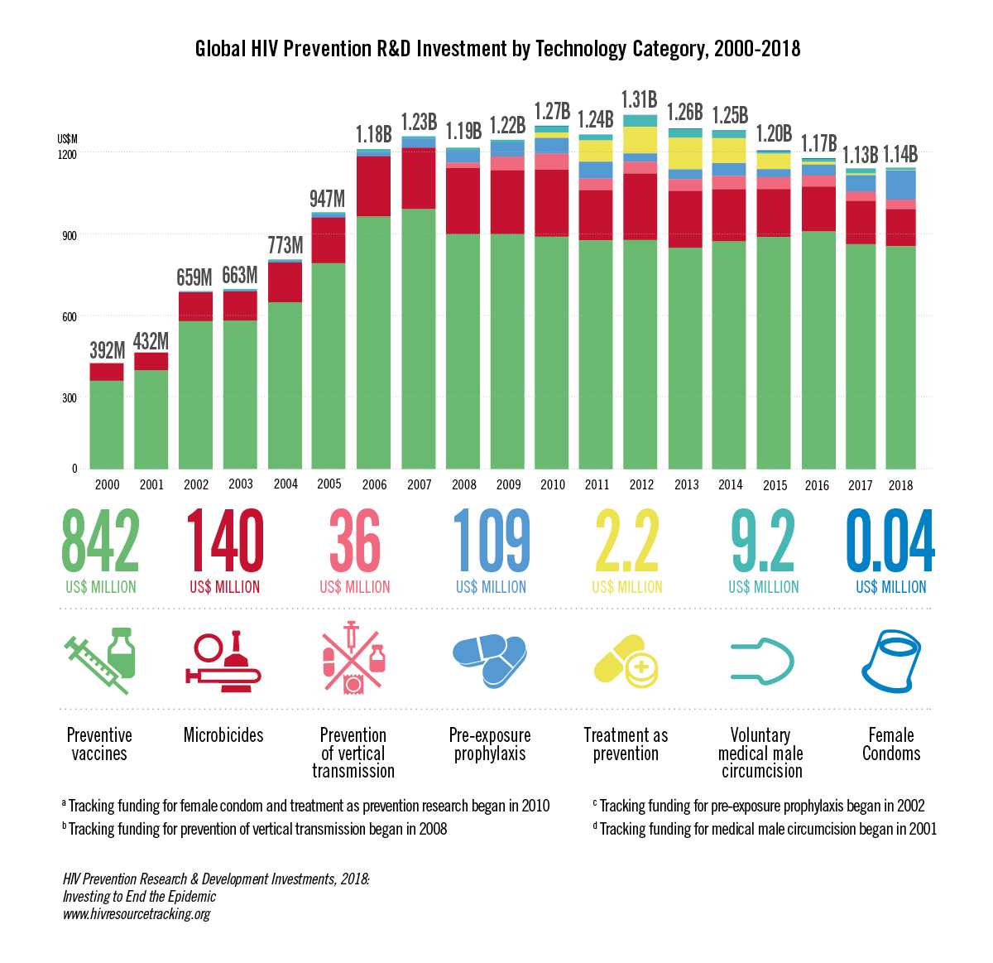
2018 Overview
Funding for HIV prevention R&D increased by 1.2% from the 2017, rising to US$1.14 billion
First time in five years that the trend of declining funding has reversed
HIV vaccines continued to make up largest share of overall funding, followed by microbicides and PrEP
PrEP investment has been rising since 2016 and are at almost 10% of global funding

Slide 7
Prevention Options on the Horizon
JANUARY
2018
JANUARY
2019
JANUARY
2020
JANUARY
2021
Dapivirine (HOPE/MTN 025)
Open-label
Vaginal ring
Dapivirine (DREAM/IPM 032)
Possible
regulatory
opinion
F/TAF (DISCOVER)
Oral PrEP
Possible
regulatory
approval
Randomized controlled
Cabotegravir (HPTN 083)
Long-acting injectable
Cabotegravir (HPTN 084)
VRC01 (HVTN 704/HPTN 085)
Antibody
VRC01 (HVTN 703/HPTN 081)
ALVAC (HVTN 702)
Preventive HIV vaccine
Ad26 (HVTN 705/HPX2008)
Ad26 (HVTN 706/HPX3002)
Visit www.avac.org/pxrd for trial status updates.

Slide 8
Importance of Population Specific Research
In 2017, 47% of new infections occurred among key populations and their partners. Risk for acquiring HIV is disproportionately higher in MSM (x28 times) and TGW and FSW (x13 times)
ECHO Study in East and Southern Africa documented infection rates that were almost 4% among sexually active women seeking contraception
New biomedical strategies are being researched and deployed, but these are often reliant on delivery and outreach strategies that are poorly defined, frequently under-resourced and variably effective

Slide 9
Sub-Analysis and Methodology
Analysis of global HIV prevention research investments for 2017 and 2018 to identify grants that were key population or priority population focused using grant abstracts and descriptions provided by funders
“Key populations” identified as MSM, sex workers, transgender people, and people who use drugs; “priority populations” included women and girls
Largely non-population specific research grants were excluded
Information on research focus of grants based on description provided by donor, which may be incomplete, particularly in the case of grants to institutions or large multi-investigator grants

Slide 10
Global Investment in KP and PP
Focused Prevention Research in 2018
US$1.14 billion

Slide 11
Small % of Prevention Research Focused on KPs
Research specifically focused on Key Populations in 2017 comprised only 2% of microbicide research, 17% of PrEP research, and 4% of TasP research
Research specifically focused on Key Populations in 2018 comprised only 2% of microbicide research, 17% of PrEP research, and 8% of TasP research

Slide 12
Global Investment in KP
Focused Prevention Research in 2017
US$227.9 million

Slide 13
Global Investment in KP
Focused Prevention Research in 2018
US$297.0 million

Slide 14
Limited BSSR Prevention Research
BSSR Research Focus | 2018 Investment USD
Female condom social and behavioral | $ 22,500
Microbicides behavioral and social science research | $ 16,193,659
PrEP social and behavioral | $ 9,349,567
VMMC social and behavioral | $ 1,792,727
TasP behavioral and social science | $ 732,615
Grand Total | $ 28,092,417
Behavioral and Social Science Research in 2018 was also limited, representing 9% of non-vaccine prevention investment

Slide 15
Why is BSSR and KP Research critical? What If It Works?

Slide 16



The Oral PrEP Experience
Oral PrEP Implementation Studies
Key Takeaways from early Oral PrEP rollout
Post-approval studies and projects
131
  Distinct post-approval oral PrEP implementation projects and studies; most were small-scale
Post-approval studies were not all designed to address decision-maker questions
Countries
Data from research was not well timed to inform decision making at global or country level
68
Different countries conducted projects including multiple in the same country (e.g. 25 in one country)
Stakeholders
54
Different organizations involved in oral PrEP implementation research
Complex, fragmented stakeholder landscape
Poor planning can limit immediate impact of biomedical prevention options

Slide 17
Avoiding Delays with Prevention Intro
Full impact of recent advances—including VMMC & oral PrEP—delayed by years because of limited advance planning for roll-out:
Limited research to identify & understand potential users until after efficacy
Lack of coordinated plans for demonstration projects – e.g., many small studies; not big or consistent enough to draw conclusions
Few tools for country-level decision makers e.g., estimated costs or impact of investments
Slow recognition of importance of and investments in strategic demand creation
Can’t do everything, everywhere at initial launch

Slide 18
Prevention Product Considerations
For each product, understand and balance:
Clinical
Biologic efficacy
Dosing
Reversibility
Side effect profile
Systemic/Topical
Policy & Programs
Delivery channel(s)
Health system burden
Product cost
Program cost
Provider training
Personal
User effectiveness
User preference
User burden
Discretion of use
Contribution to stigma

Slide 19
Conclusions
Level of investment in key population-specific prevention research suggests field is not sufficiently resourcing the necessary intersection of biological risk, preferences, and social determinants that affect uptake and effectiveness of new prevention options
Research in key populations is critical to inform development of prevention interventions with positive public health impact, effectively engage civil society in product development, and implement human-centered design research, yet it remains an underfunded and underutilized tool

Slide 20
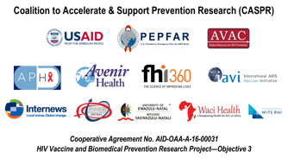
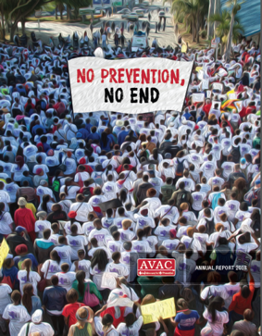
Thank You
www.avac.org and hivresourcetracking.org

